Slide 1
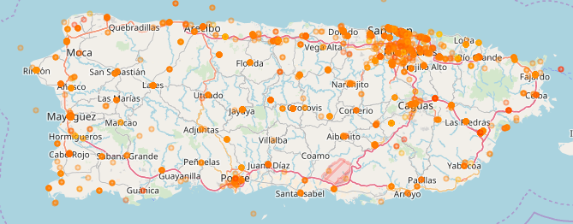





Public Perception to the Government Response to Hurricane Maria in Puerto Rico
Collaborators:
COL Joseph Lindquist
LTC David Risius
MAJ Karoline Hood
CPT Patrick Kuiper
CPT Dusty Turner

Slide 2
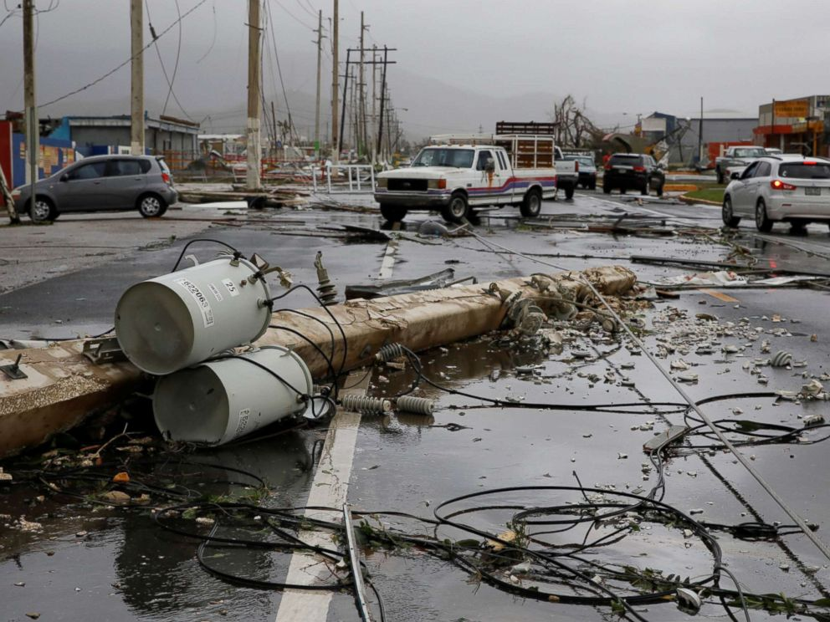
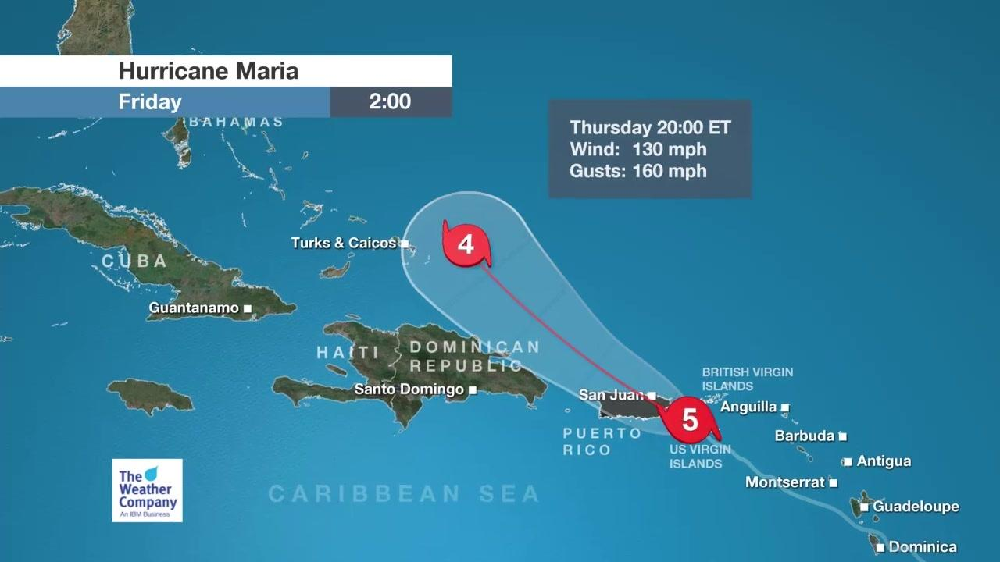
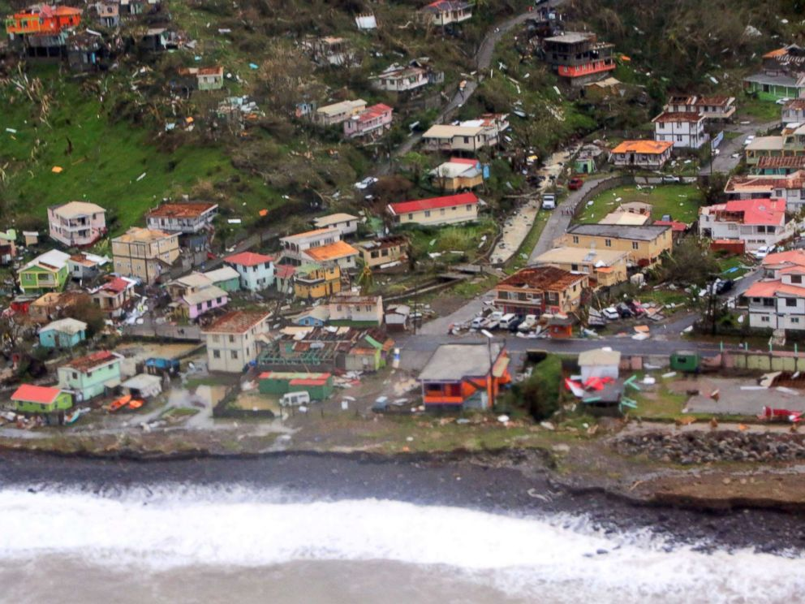
Hurricane Maria
Landfall: 18 September 2017
Winds: 175 MPH
Fatalities: ~ 547
Damage: ~ $99.5 Billion
www.weather.com
www.wikipedia.com

Slide 3
Problem Statement
How does the Puerto Rico Populace View the Response by the United States Government?

Slide 4
Typical Solutions to Answer This Question
Person to Person Interviews
Telephone Interviews
Focus Groups
Mail Surveys
Time consuming
Expensive
Truth changes
Cannot reach all people
How does the Puerto Rico Populaces View the Response by the United States Government?

Slide 5
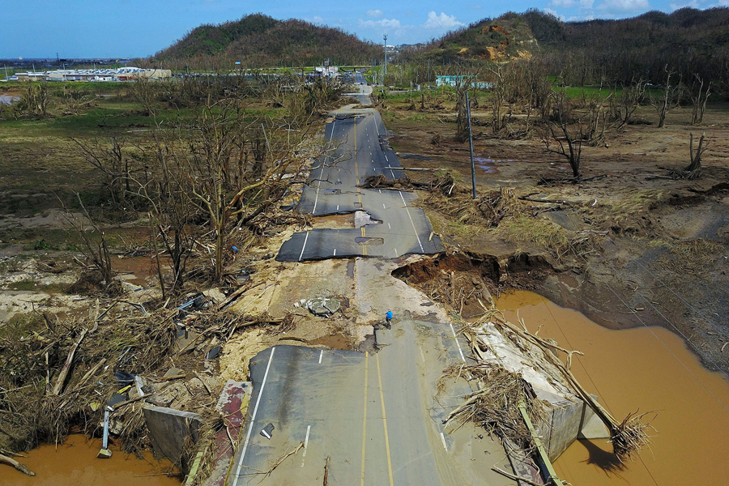
Enter: Twitter
Proposed Solution: Look at Twitter for ‘real time’ information
Why this is good:
Up to the second data
Sample over a wide geographic area
n = all twitter users
Why this is bad:
Biased sample
n = all twitter users
Thought Experiment:
What else are you going to do?
https://www.theatlantic.com

Slide 6


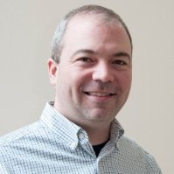
Enter: twitteR
Need:
R
‘twitteR’ Package
Twitter Handle
Twitter API
Request:
Search Term: Puerto Rico
Search Dates: Last 7 Days – 24 Sept 17
Search Location: 100 miles from PR Center
Jeff Gentry
geofjentry
@jeffgentry

Slide 7
Enter: Twitter and twitteR
Set up program:
library(twitteR)
api_key <- “your_API_key"
api_secret <- “your_secret"
access_token <- “your_access_token"
access_token_secret <- “your_token_secret"
setup_twitter_oauth(api_key, api_secret, access_token, access_token_secret)
Execute program:
Currently 350,000+ Tweets
latest <- searchTwitter(searchterm, n = n,
since = since,
until = until,
geocode = '18.221,-66.59,100mi')

Slide 8
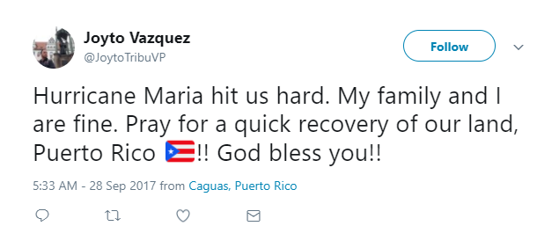
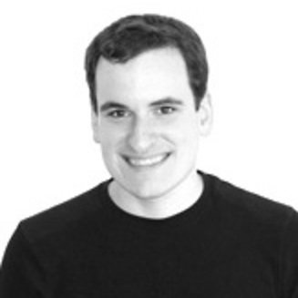
Enter: tidytext
Analyze Sentiment
“Tokenize” every tweet
Remove “Stop” Words
Remove Symbols
“Lower Case” all words
Translate Spanish
Score Words
David Robinson
dgrtwo
@drob

Slide 9

Enter: tidytext
Tokens
hurricane
maria
hit
us
hard
my
family
and
i
are
fine
pray
for
a
quick
recovery
of
our
land
puerto
rico
god
bless
you
Clean
hurricane
maria
hit
hard
family
fine
pray
quick
recovery
land
Puerto
rico
god
bless
Clean | Lexicon
 | NRC | Bing | Afinn
hurricane | negative
maria
hit | negative |  | -1
hard |  | negative
family
fine |  | positive | 2
pray | positive |  | 1
quick
recovery |  | positive
land | positive
Puerto
rico
god | positive |  | 1
bless | positive | positive | 2
$$score=\frac{\sum{positive}−\sum{negative}}{\sum{positive}+\sum{negative}}$$
 | NRC | Bing | Afinn
Score | 1/3 | 1/4 | 5/7

Slide 10
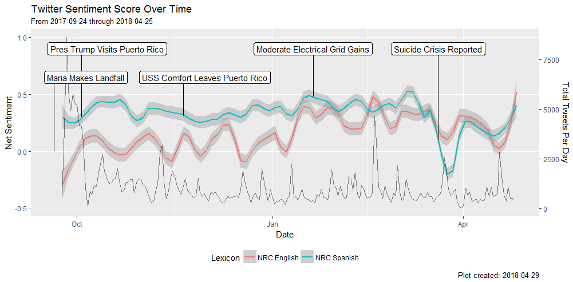
Twitter Sentiment

Slide 11
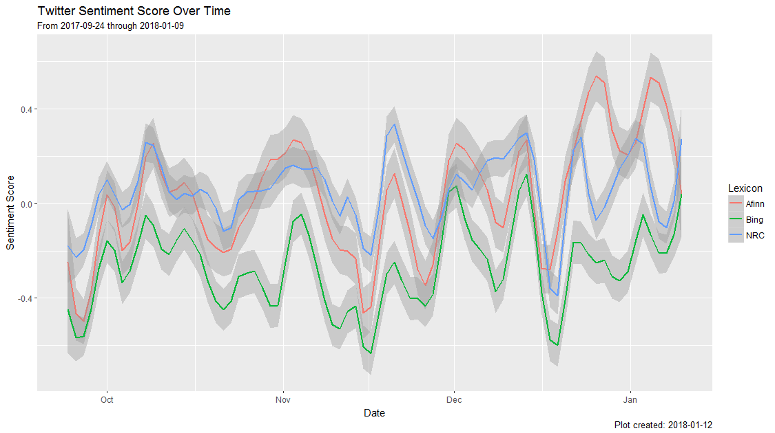
Validation Methods
Comparison of Lexicons
LOWES Smoother (Locally Weighted Scatterplot Smoothing)

Slide 12
Validation Methods
Comparison of Lexicons
LOWES Smoother (Locally Weighted Scatterplot Smoothing)

Slide 13
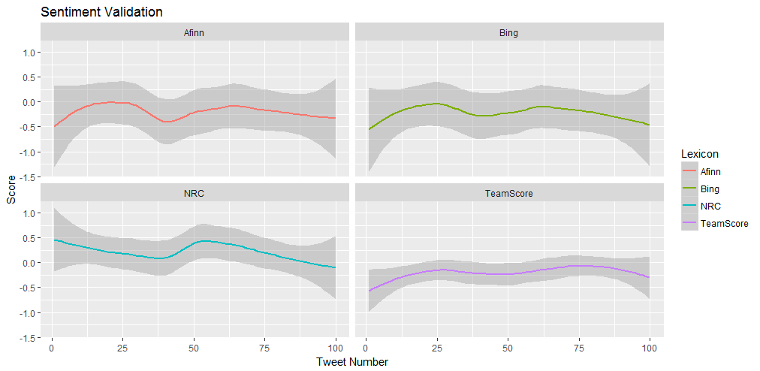
Validation Methods
Tweet Scoring

Slide 14
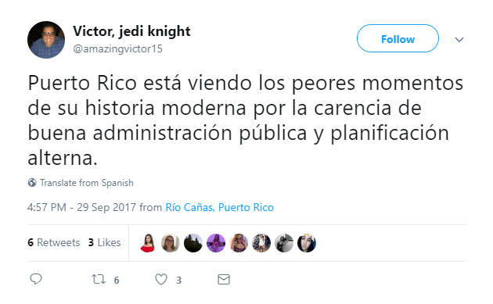
Issue:
~60% of Tweets are in Spanish
~60% of sentiment being overlooked

Slide 15
Solution:
NRC’s tedious Spanish to English translation

Slide 16
Validation Methods
Tweet Scoring

Slide 17

Enter: Google News
Need:
R
‘Rvest’ Package
URLs of interest
Cascading Style Sheets (CCS) Selector
Hadley Wickham
hadley
@hadleywickham

Slide 18
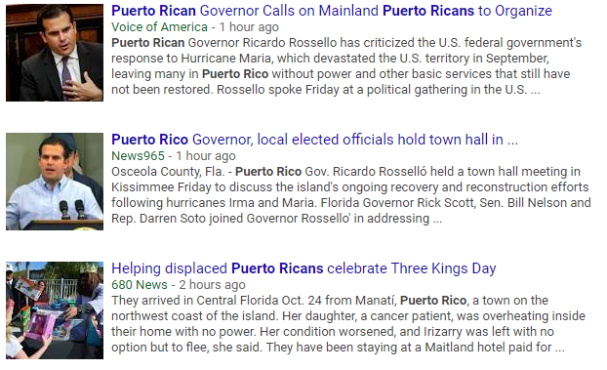
Enter: Google News
Google = c(“URL1”, “URL2”,...,”URLN”)
headlines <- google[1] %>%
read_html() %>%
html_nodes(".r") %>%
html_text()
Sys.sleep(sample(10, 1) * 0.1)
blurb <- google[1] %>%
read_html() %>%
html_nodes(".st") %>%
html_text()
Sys.sleep(sample(10, 1) * 0.1)
origins <- google[1] %>%
read_html() %>%
html_nodes(".slp , ._gJs") %>%
html_text()

Slide 19
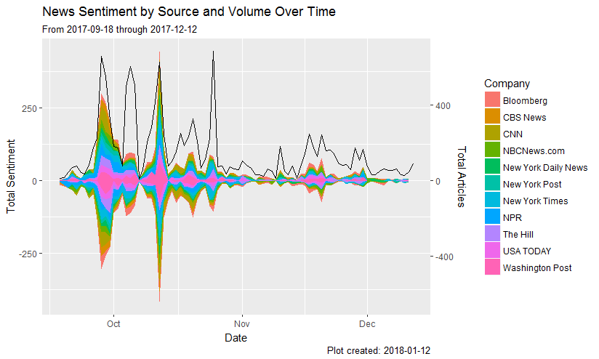
Enter: Google News

Slide 20
Interactive Shiny App
“On The Ground” Tool
Live
Interactive
https://dustyturner.shinyapps.io/PuertoRico/

Slide 21
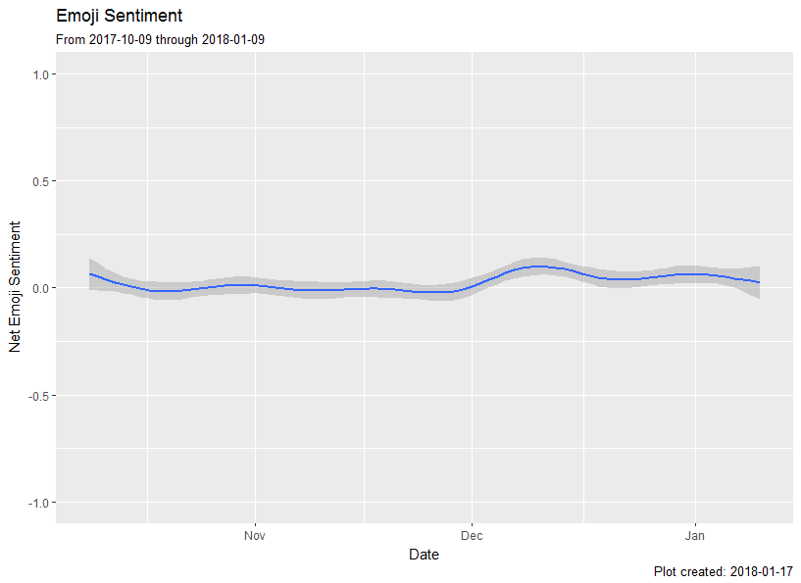
Emoji Analysis
Count | Emoji
1392 | 🖤
960 | 😂
821 | 😭
582 | ☕
529 | 😍
501 | 🔥
462 | 💪
395 | 🙏
336 | 👏
331 | 🙌

Slide 22
Automated
R package
Devtools::install.github(“dusty-turner/puertoRicoR”)
Shareable
Grow-able
Collaborative

Slide 23
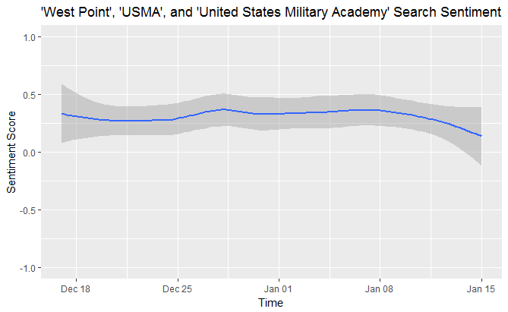
Reproducible / Extendable
"Social media analysis and crowd-sourcing need to be utilized for future DSCA events. These tools can help us gain and maintain situational awareness of the operating environment and we should have the tools set up prior to the event occurring".
- LTC David J. Risius
US Army North ORSA

Slide 24
Future Work
Domain Specific Lexicon
Bi-gram analysis
“Central Nodes” of Twitter users
Minimize “bots”

Slide 25
Inherent Issues
Twitter:
Bias of who uses twitter
Bias of who can use twitter
Over weighing influential ‘tweeters’
“People are NOT happy in PR” = +1
Spanish ~ Espanol
Google:
Limited to “blurbs”
Bias of news sources

Slide 26
Rehash of Benefits
Twitter:
Provides a snapshot of the population
Up to the second insight
Google:
Provides insight of what people are reading
Leverage news outlets for public image

Slide 27
Feedback Welcome!
Collaborators:
COL Joseph Lindquist
LTC David Risius
MAJ Karoline Hood
CPT Patrick Kuiper
CPT Dusty Turner

